Slide 1
CIS 800: Old and New Research in Networked Systems
Vincent Liu
Fall 2018
Some slides from Mohammad Alizadeh, Scott Shenker

Slide 2
The Internet: An Exciting Time
One of the most influential inventions
A research experiment that escaped from the lab
… to be the global communications infrastructure
Ever wider reach
Today: 2 billion users, 15 billion devices
Tomorrow: more users, content, sensors, “things”, 40 billion devices by 2020
Constant innovation
Web, P2P, video, online shopping, social networks, cloud, …

Slide 3
Transforming Everything
The ways we do business
E-commerce, advertising, cloud computing, ...
The way we have relationships
E-mail, IM, Facebook friends, virtual worlds
The way we think about law and govern
Interstate commerce, national boundaries?
Censorship and wiretapping
The way we fight
Cyber-attacks, including nation-state attacks

Slide 4
This course
... is about two very different classes of research: the old and the new
Main goal:
Prepare for high quality research in this field

Slide 5
Readings and Reviews
We will read one paper per class
Every expected to read the papers in advance
Tuesdays: New
Thursdays: Old
Submit reviews on Piazza
Submit a short review of the required reading by midnight the night before class
Paper summary (1 short paragraph), strengths (~2 sentences), weaknesses (~2 sentences), Comments (A few points)
Say something that is not in the paper
Say something that others have not said

Slide 6
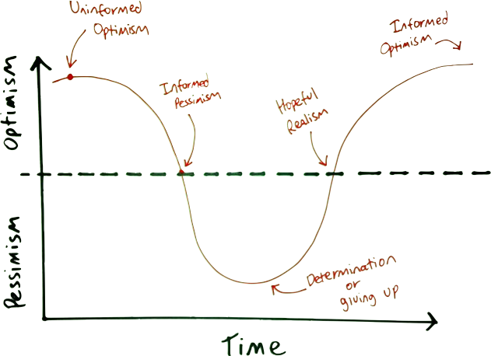
A Warning
Don’t be too negative!
Review to accept, don’t review to reject
Not every paper needs to be a ”test of time” winner to have worth

Slide 7
A Warning (Part 2)
“There is a tendency in our field to believe
that everything we currently use is a
paragon of engineering, rather than a
snapshot of our understanding at the time. We
build great myths of spin about how what
we have done is the only way to do it to
the point that our universities now teach
the flaws to students (and professors and
textbook authors) who don’t know better.”
-John Day

Slide 8
Leading Discussion
Each student will present two papers
One old, one new
Give a presentation as well

Slide 9
Project Timeline
Proposal (1-2 paragraphs) Sept. 11
Midterm Report (1-2 pages) Oct. 16
Final Report (6+ pages) Dec. 4

